Slide 1
Platelet Counts

Slide 2
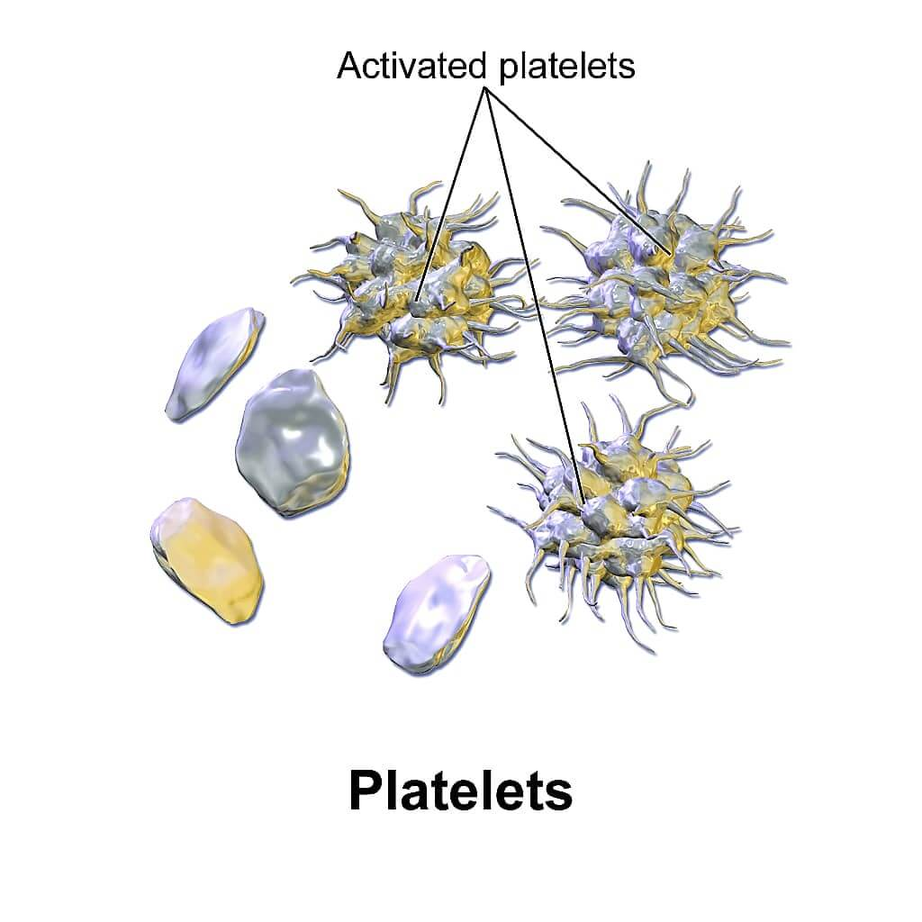
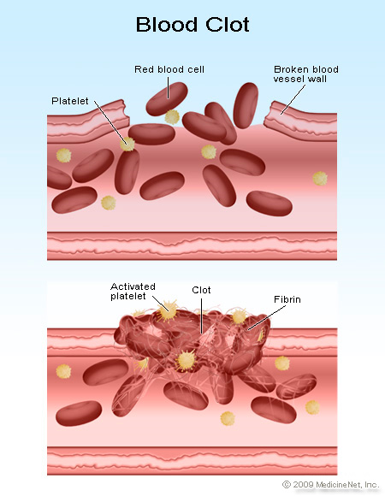
Platelets:
Platelets are the smallest formed elements in the blood, normally ranging in size from 2-4 microns.
Platelets function in the coagulation of blood.
A normal platelet count is 150,000-400,000/c.mm.in human

Slide 3
Objectives :
To determined the platelate count of the provided sample.
Normal value in some animales
300,000-600,000 µL goat
250,000-750,000 µL sheep
100,000-600,000 µL horse
100,000-800,000 µL cow

Slide 4
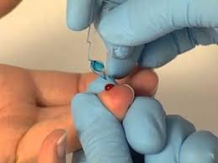
Procedure \ Materials needed:
Whole fresh blood.
RBC Pipette.
Ammonium oxalate 1%, in a distilled water.
Hemacytometer chamber.
Microscope.
Petridish.
Pipette rotator.
Filter paper.
Alcohol.

Slide 5
HEMACYTOMETER CHAMBER

Slide 6
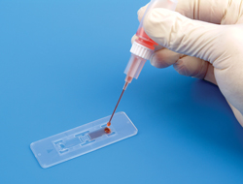
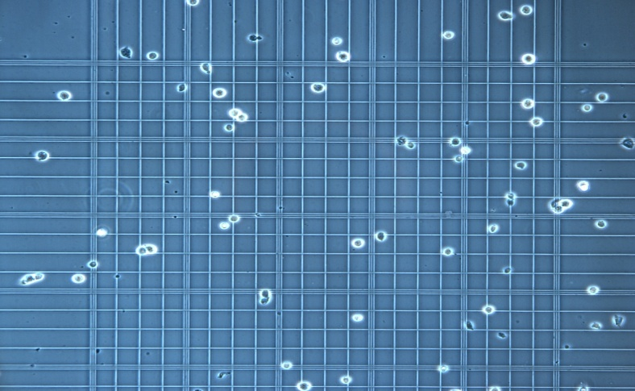
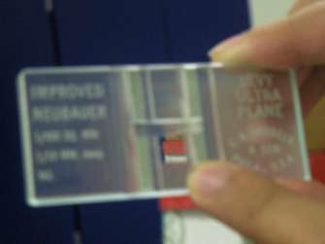
Procedure:
Using RBC Pipette with drawn blood to exactly 0.5 mark; then dilute to 101 mark with ammonium oxalate(dilution 1:200).
Place the pipette on a pipette rotator for 10-15 minute to ensure complete haemolysis of RBC'S.
Discard the first five drops from the RBC pipette and fill besides of the haemocytometer.

Slide 7
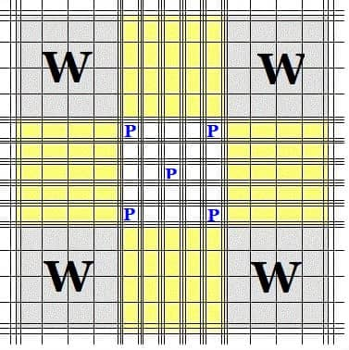
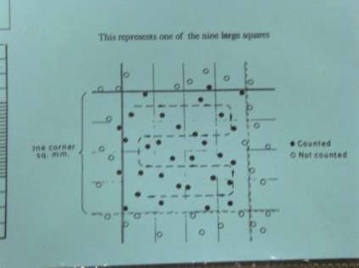
Placed the haemocytometer in a moist petridish; and leave it for 20-30 min.(this allow the platelate to settle and prevents evaporation of fluid).
Put the haemocytometer on microscope and exam. Under power 10x.
Then change the exam. to power 40x; the plat. appears round or oval bodies with alight purplish sheen( fine process may be seen).
The platelate are counted in the central big square (which contain 25 small squars).
Counting the no. of plat. in both sides of chamber; add two count to other and determined the average number of platelets counted.

Slide 8
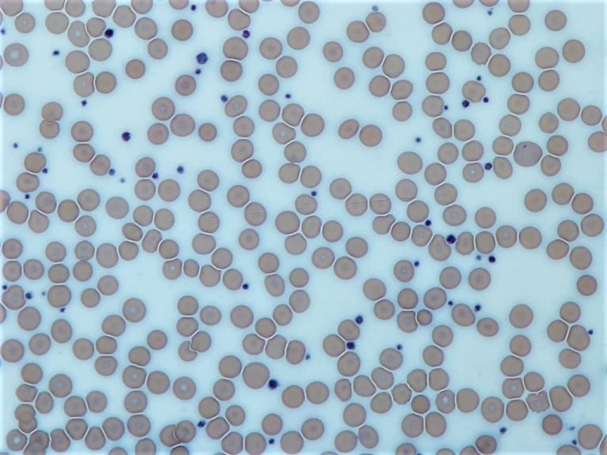
CALCULATIONS:
platelets\ c.mm = N X dilution \volume.
Dilution : 1:200
Volume: the volume of diluted blood used, which is areas (1mm² )x depth(0.1mm) which equals to = 0.1 c.mm.
PLTcount=N (25)×1000 /mm3

Slide 9
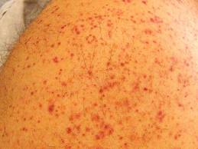
Interpretation of Results:
Thrombocytopenia:Platelet counts below normal:
A plastic anemia.
Pernicious anemia.
Acute leukemia's.
Idiopathic thrombocytopenic purpura.

Slide 10
Thrombocytosis: Platelet counts above normal:
Polycythemia Vera.
Hemolytic anemia.
Chronic myeloproliferative disorders.
After splenectomy.

Slide 11
Sources of error
Precautions to be taken
• Glassware must be scrupulously cleaned . debris and dust are the main sources of error as they are easily mistaken for platelets.
• The diluting fluid must be filtered just before use . to remove particles.
• If venous blood is used the platelets must be counted within 3 hours. delay causes disintegration and clumping of platelets.
• Blood should be rapidly diluted . this is essential to prevent clumping.
Precautions to be taken
• Blood must be thoroughly mixed with the diluents by shaking the contents at least for 10 minutes. inadequate mixing results in clumping of platelets.
• The charged chamber should be kept for 15 minutes under Petri dish. to prevent evaporation and for the cells to settle down.
• If other hematologic tests are to be done with platelet count ,and blood is used from the same puncture ,take blood for the platelet count first. •
The finger should not be squeezed excessively to collect blood

Slide 12
Thanks

